Slide 1
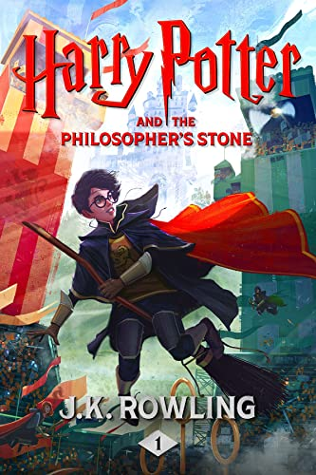
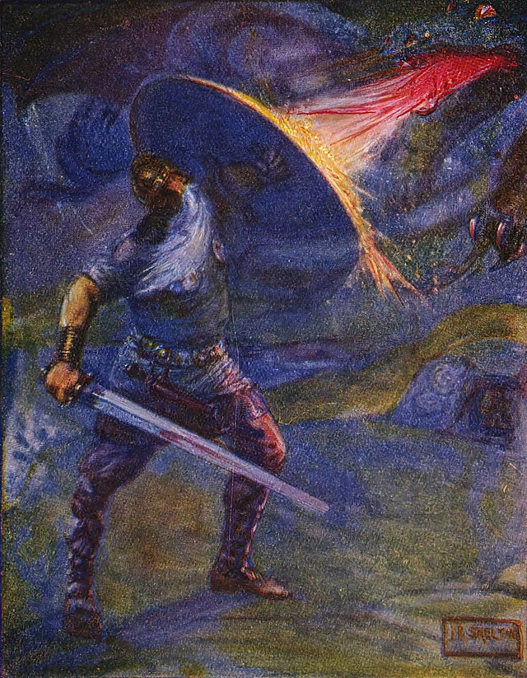
and
Presentation by Sara Tonghini 3Clic

Slide 2
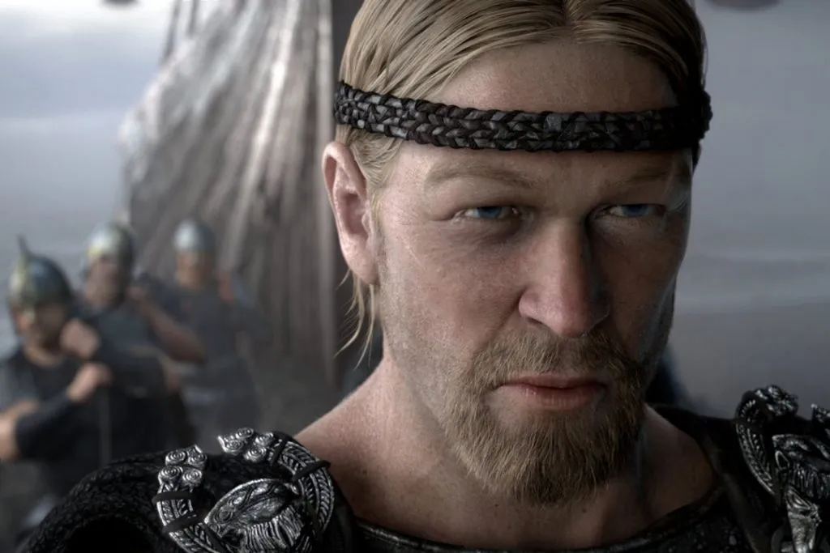
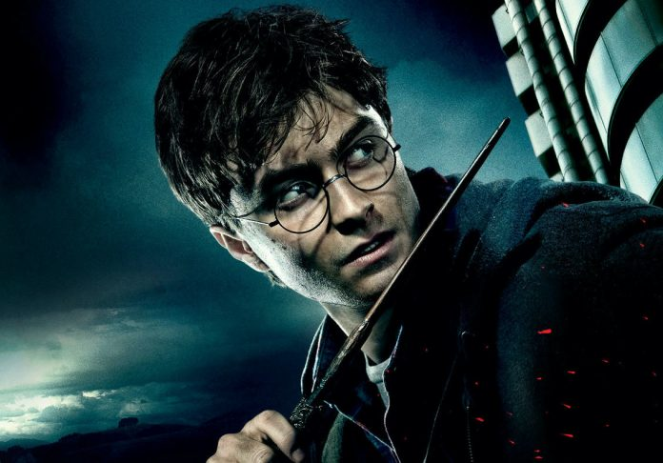
Two heroes
Both Harry Potter and Beowulf are heroes, described in two different periods and cultures.
However, Beowulf influenced a lot the series of novels written by J.K. Rowling, and the readers can find some common characteristics between the two masterpieces.

Slide 3
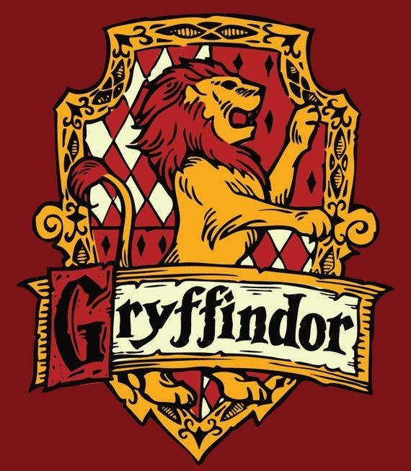
Bravery
The main characters share bravery, a quality that makes them heroes.
The bravery shown by Beowulf during the battles, in particular the one against Grendel, changes his reputation from a simple warrior to a hero. Another moment of bravery is when he manages to defeat Grendel’s mother in her own house, leaving every scary thought.
Harry Potter is considered a brave guy, too, since he was chosen to be a member of the Gryffindor house in Hogwarts. He is considered a symbol of courage in the whole series, because he succeeds in dealing with every kind of obstacle his life presents to him.

Slide 4
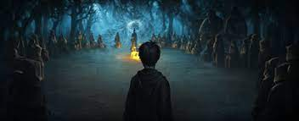
Sacrifice
Beowulf gives his life for his people fighting against the dragon. In fact the dragon has been attacking his kingdom. He also asks for the dragon’s treasure to be used for his people.
In the last Harry Potter’s book, the theme of sacrifice is reported when Harry decides to fight against Lord Voldemort alone to make the wizard’s world safe again, even if he knows he’s risking death.

Slide 5
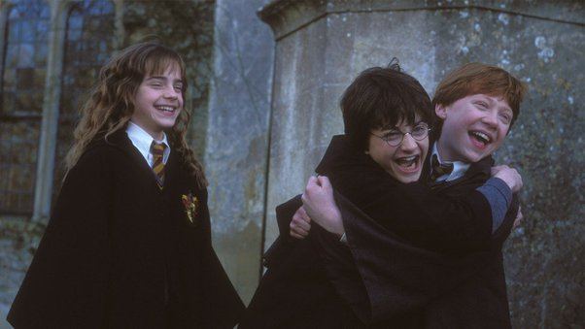
Loyalty
When Beowulf goes to fight the dragon that is attacking the kingdom, he finds that it will be impossible to defeat the dragon alone due to his old age. Beowulf brings some of his men along on this fight. One of them, Wiglaf, helps Beowulf while he is injured during the battle.
Harry Potter is surrounded by people who love him, like his two best friends, Ron and Hermione, who are always there by his side. The loyalty between the members of the trio makes every victory happier and their friendship is important because it gives them strength and support.

Slide 6
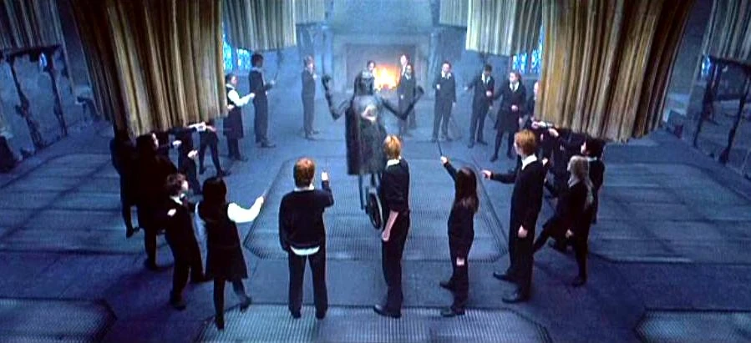
Leadership
Beowulf is loved by everyone and no one attacks Geatland, his kingdom, while he is king. In fact the critic Napierkowski describes Beowulf as
“a premier example of literature as a form of leadership instruction”.
Harry Potter, at the same time, shows that he can be a good leader, for instance by teaching his classmates how to perform difficult magic tricks. He organises some secret meetings for them to show the importance of cooperation and he succeeds in transmitting his knowledge.

Slide 7
Different periods, same values
8th century
11th century
20th century
21st century
Beowulf
Harry Potter
(1997-2005)
Even if the production of these two works is linked to two different historical moments far in time, the values that a hero should have are still the same, and they both have a purpose: showing that everyone can be a hero, if he/she follows the principles that make a hero like that.

Slide 8
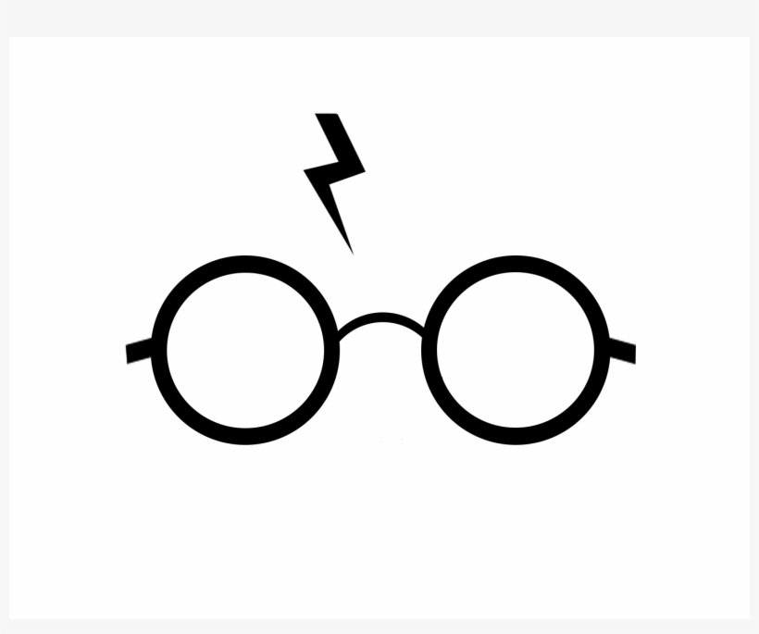
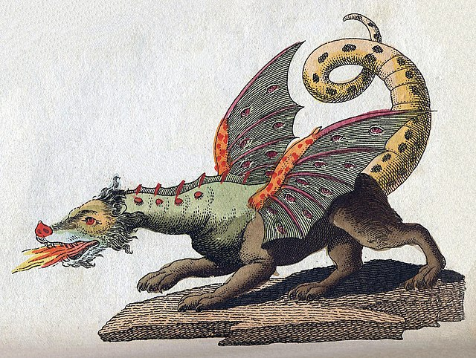
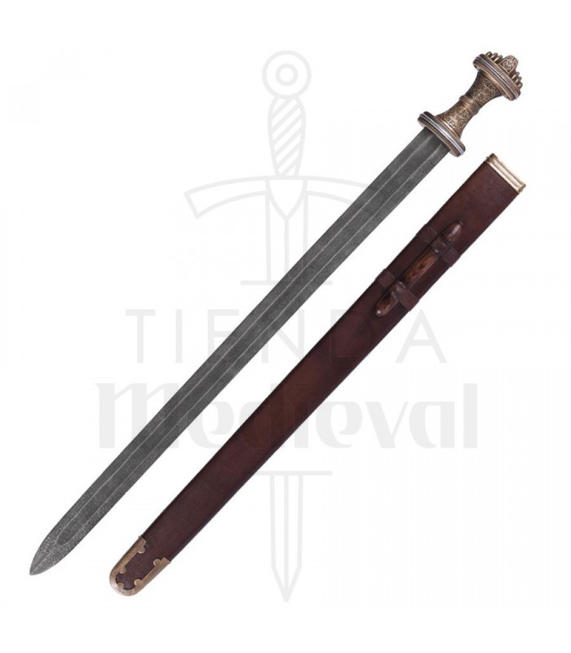
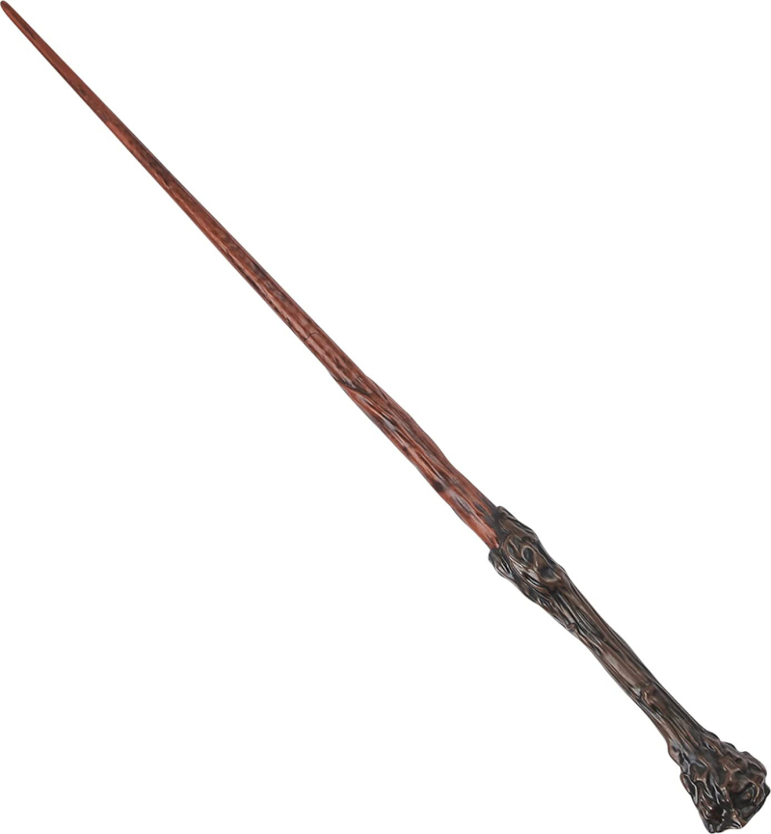
THE END
Thanks for your watching

