Slide 1
Genetically modified crops
Presentation by
Colnaghi Maria, Grossi Katia, Lanfredi Cecilia and Tonghini Sara

Slide 2
GMO LABELLING
All around the world there are different rules about the labelling of GMO:
-In Italy, Russia, Australia, New Zealand, Hungary, France, Spain, U.K., Sweden, Greenland, the government requires a mandatory labelling with a threshold of 0.9% GMO content.
-In China and Brazil, the country requires instead a mandatory labelling with a threshold of 1% or higher.
-In the United States, Canada, Mexico there is no food labelling law about GMO.
-The only countries against GMO are Zambia, Benin and Serbia, where there is an official ban on GMO food imports and cultivation.

Slide 3
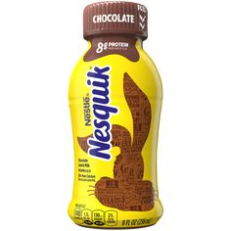
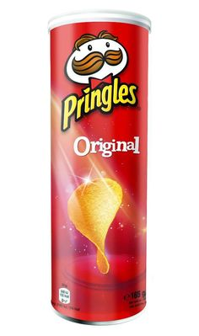
SOME PACKAGED FOOD….
In many countries of UE and the USA, companies use genetically modified crops to make their products. On the American black list there are a lot of companies that use genetically modified ingredients in their goods, such as Mars, Coca-Cola, Nestlè and Parmalat.
Today, on some Internet sites, we can find some advice of what we have to do before buying something:
– Read the labels: the producer has to specify if the product contains GMOs. – Avoid fast food restaurants because most probably they contain GMOs. – Avoid bagged bread or bread with a high percentage of preservatives. – Probably, all the corned beef, sausages and cured meat are made with the addition of genetically modified components. In fact, it’s impossible that an organic product is sold so cheaply.

Slide 4
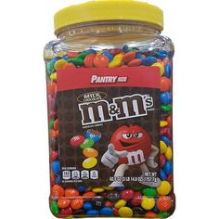
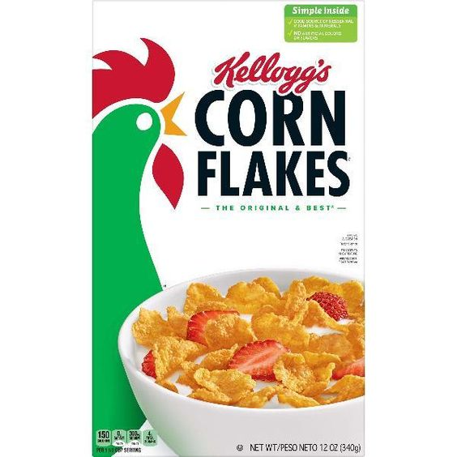
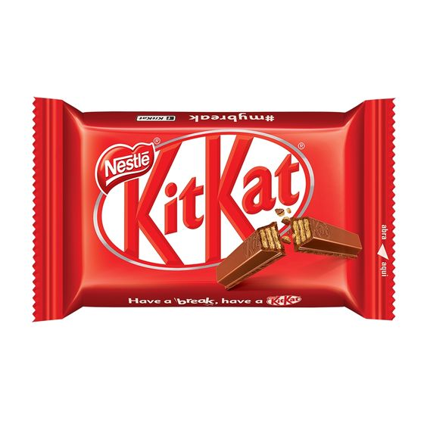
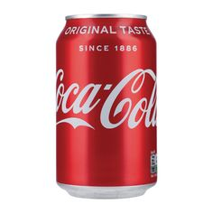
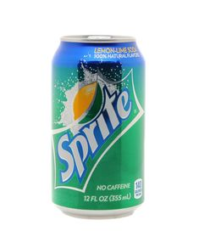
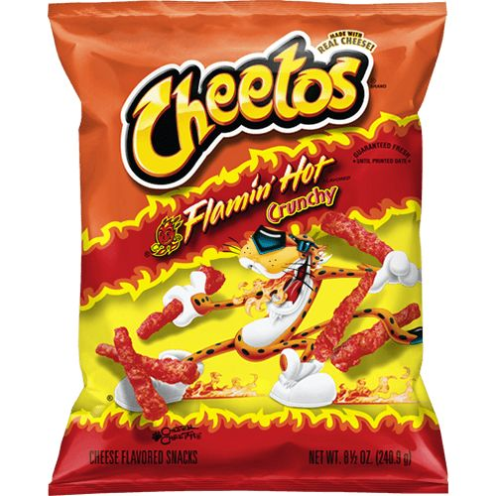
… THAT WE EAT EVERY DAY
Here are some kinds of food that we’ve eaten at least once in our lives containing GMOs:
-Corn Flakes (cereals); -Kit-Kat (chocolate bar); -Baci (chocolates); -M&Ms; -Nesquik (chocolate drink); -Coca-Cola; -Sprite; -Pringles (chips);

Slide 5
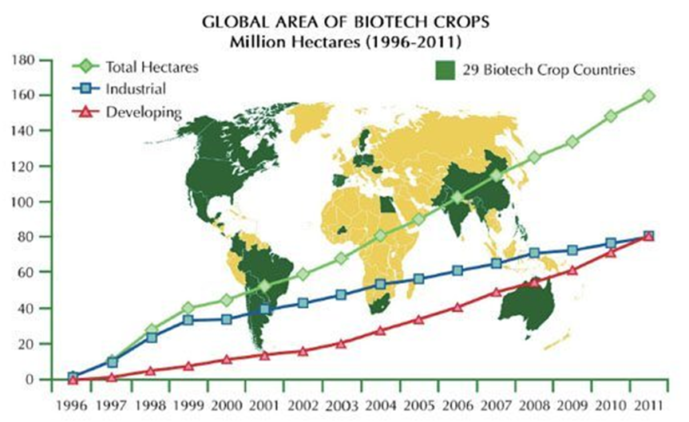
SOME INFORMATION ABOUT THEIR DEVELOPMENT
This graphic represents the developing of GMO products during the last years, in particular from 1996 to 2011.
The blue line represents the developing of GMO crops in industrial countries.
The red one represents their growth in developing countries. Until 2011 the blue line is much higher than the red one, but in that year we can say that the lines overlap.
Today the red line would stand on the blue one.

Slide 6
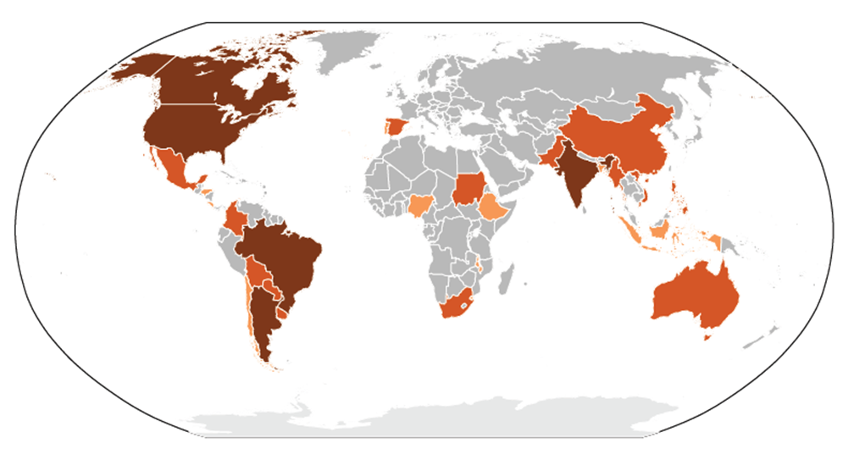
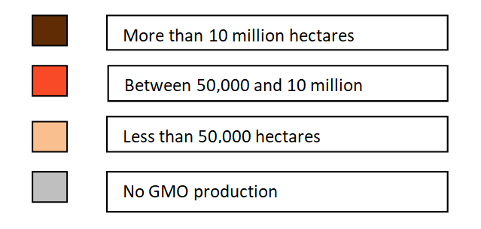
This graphic represents the main areas dedicated to the production of GMOs in 2017. Areas cultivated with transgenic GMOs are still mainly located on the American continent, as well as in China and India.
The American continent (United States, Argentina, Brazil and Canada) hosts more than 85% of transgenic crops.

Slide 7
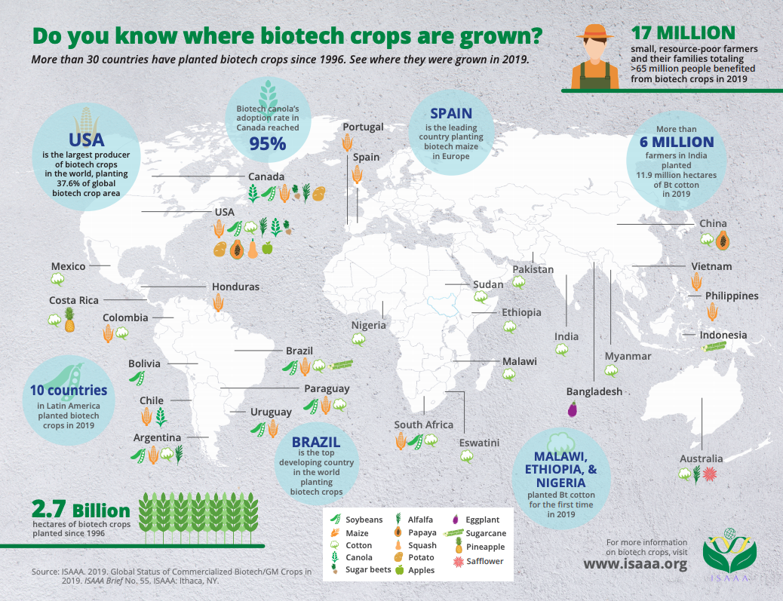

Slide 8
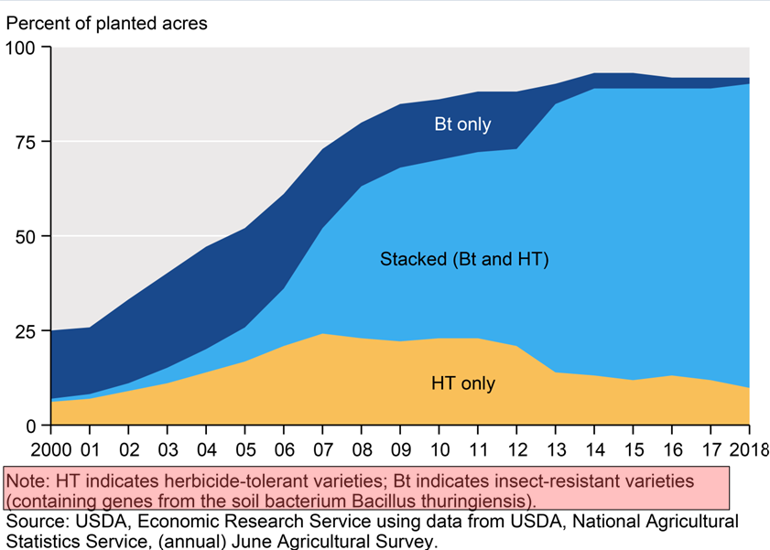
This graphic describes the development of crop varieties focusing on their goal.
HTs are the GMOs developed especially to contrast herbicides; BTs are those created against insects.
At first the percentage of fields used for the production of BTs was more or less the same than the one used for HTs.
Starting from 2006-2007 we can see a very high development of varieties which are both herbicide-tolerant and insect-resistant. This is clear because the light-blue area is much bigger than the other two.

Slide 9
GMOs ADVANTAGES
Advantages for crops:
taste and product quality improving;
products growth time reducing;
yield, nutrients and stress tolerance increasing ;
resistance to diseases, pests and herbicides improving;
new products and cultivation methods introducing.
Advantages for animals:
productivity, disease resistance and food quality increasing;
higher yields of meat, eggs and milk;
animal health and diagnostic methods for treating diseases improving.
Advantages for our environment:
'friendly' bioherbicides and bio-insecticides;
conservation of soil, water and energy;
better management of natural waste;
biological process for forestry products;
more efficient treatments.
Advantages for society: increased likelihood of guaranteed food for growing populations.

Slide 10
GMOs DISADVANTAGES
Disadvantages for health:
potential impact on human health, the environment and loss of biodiversity, flora and fauna.
access and moral properties:
economic domination of world food production by a few companies;
dependence in industrialised nations on the developed countryside increasing;
biopiracy: foreign exploitation of natural resources.
Ethics:
violation of natural organisms values;
objection to the implantation of animal genes into plants.
stress for animals.
Labelling:
not compulsory in some countries;
combining GMO wheat with non-GMO wheat makes labelling unclear.
Society: new acquirements could favour rich countries’ interests.

Slide 11
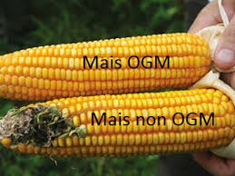
DIFFERENCES BETWEEN GMOs AND NATURAL FOOD
A first difference is represented in the product label: in fact, on the label of a product that isn’t genetically modified, we can find the sign “GMO free” in a green circle with some leaves on it.
Looking at the photo we can notice that there are also some physical differences between a GMO product and a natural one.
Another difference might be their taste: sometimes the taste of a GMO product is better than the taste of a natural product.
In some scientists’ opinion, there are also some differences between GMO products and natural ones.
An example of the label of a natural product.

Slide 12
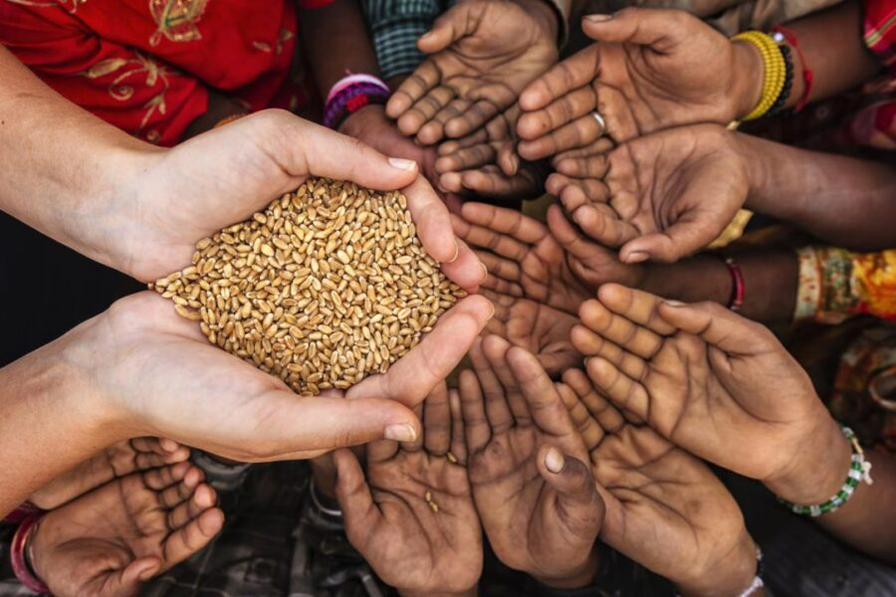
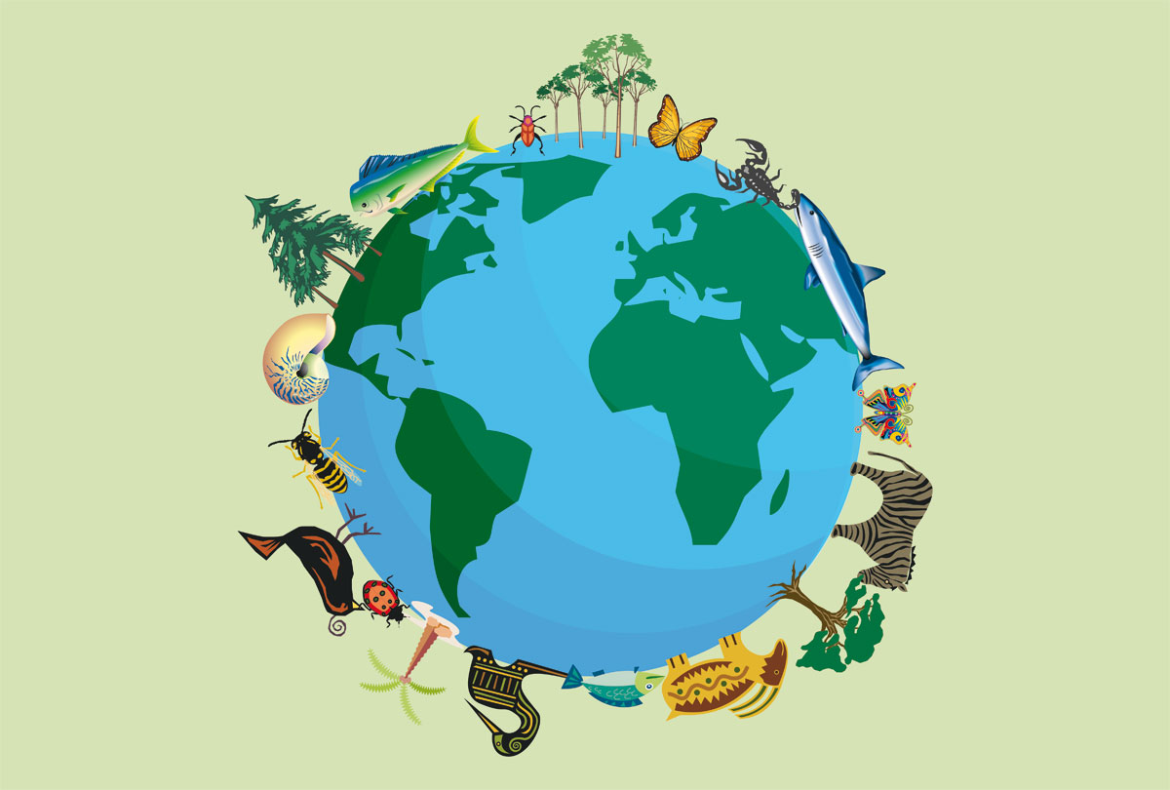
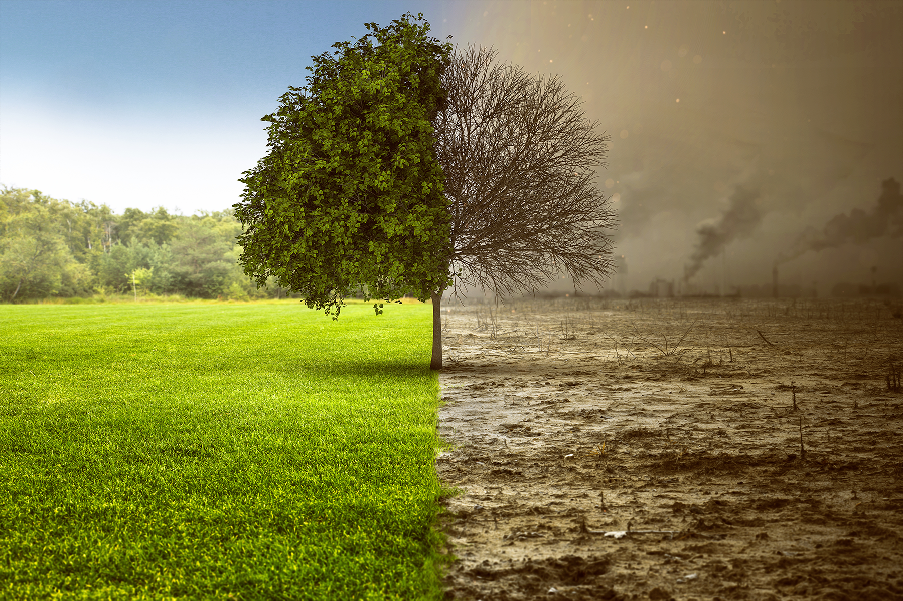
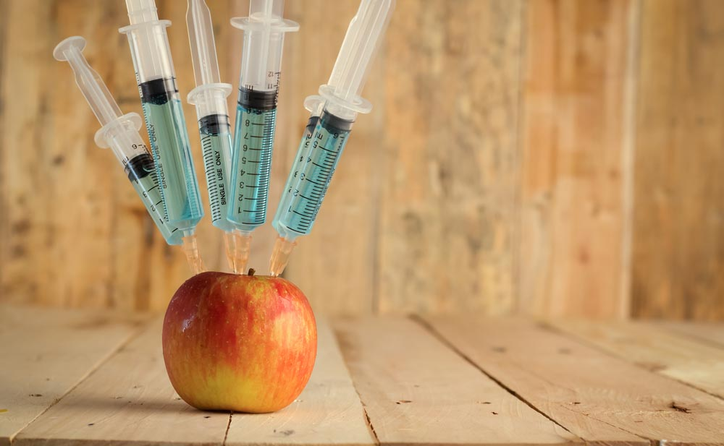
OUR CRITICAL POINT OF VIEW
We tried to answer to some questions about food that contains GMOs.
WILL GMO PRODUCTS STOP HUNGER IN THE WORLD?
ARE GMO PRODUCTS A PROBLEM FOR BIODIVERSITY?
DO GMOS CAUSE POLLUTION?
ARE GMO PRODUCTS A RISK FOR PEOPLE?

Slide 13
THE END
Thanks for your watching

